Slide 1

REAL ESTATE REGRESSION ANALYSIS
Mara Vallejos Mihotek
Data Analysis Bootcamp
Ironhack – Barcelona
July, 2023

Slide 2

Data information
Objective: develop predictive model to understand housing market selling prices with empashis in properties with prices above $650,000
Dataset consists of information of 21500 properties (21 variables)
It has been processed as follows:
Data cleaning
Data exploration
Data transformation
Model testing: Ordinary Least Squares, KNN and MLP
Significance level: 0,9
Scaled
Dummy variables

Slide 3
Model’s train-tests results
train-test | Mean Squared Error | Root Mean Squared Error | R-Squared | Adjusted R-Squared
OLS1 | 0.000435 | 0.020853 | 0.806962 | 0.803960
OLS2 | 0.000536 | 0.023148 | 0.764330 | 0.761028
OLS3 | 0.000565 | 0.023764 | 0.753991 | 0.750638
KNN1 | 0.000844 | 0.029044 | 0.630114 | 0.624361
KNN2 | 0.000880 | 0.029669 | 0.614013 | 0.608603
KNN3 | 0.000892 | 0.029872 | 0.608710 | 0.603376
MLP1 | 0.000576 | 0.023997 | 0.747493 | 0.743566
MLP2 | 0.000641 | 0.025327 | 0.718716 | 0.714774
MLP3 | 0.000794 | 0.028187 | 0.651621 | 0.646872
8 variables
Correlation and multilinearity
P-values

Slide 4
Model’s train-tests results
train-test | Mean Squared Error | Root Mean Squared Error | R-Squared | Adjusted R-Squared
OLS1 | 0.000435 | 0.020853 | 0.806962 | 0.803960
OLS2 | 0.000536 | 0.023148 | 0.764330 | 0.761028
OLS3 | 0.000565 | 0.023764 | 0.753991 | 0.750638
KNN1 | 0.000844 | 0.029044 | 0.630114 | 0.624361
KNN2 | 0.000880 | 0.029669 | 0.614013 | 0.608603
KNN3 | 0.000892 | 0.029872 | 0.608710 | 0.603376
MLP1 | 0.000576 | 0.023997 | 0.747493 | 0.743566
MLP2 | 0.000641 | 0.025327 | 0.718716 | 0.714774
MLP3 | 0.000794 | 0.028187 | 0.651621 | 0.646872
8 variables
Correlation and multilinearity
P-values
waterfront | 0.090678
sqft_living15 | 0.068709
sqft_lot15 | 0.049446
sqft_basement | 0.032335

Slide 5
Analysis

Slide 6
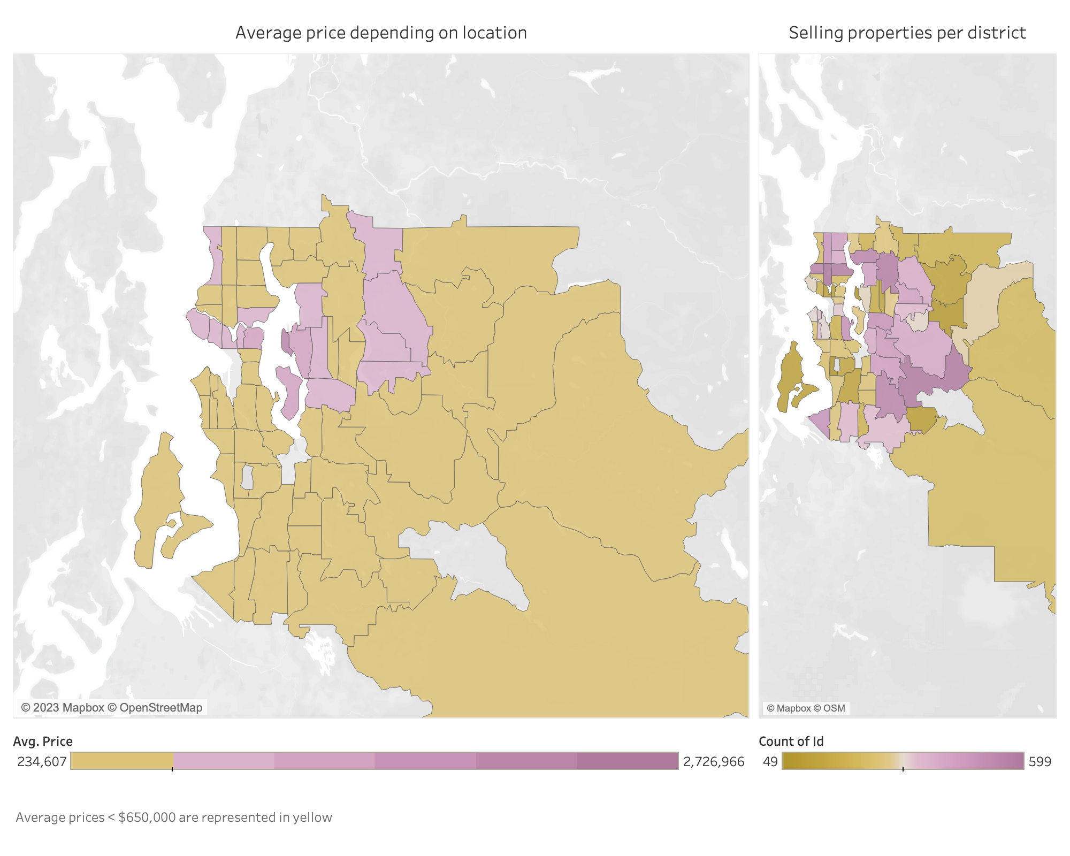

Slide 7
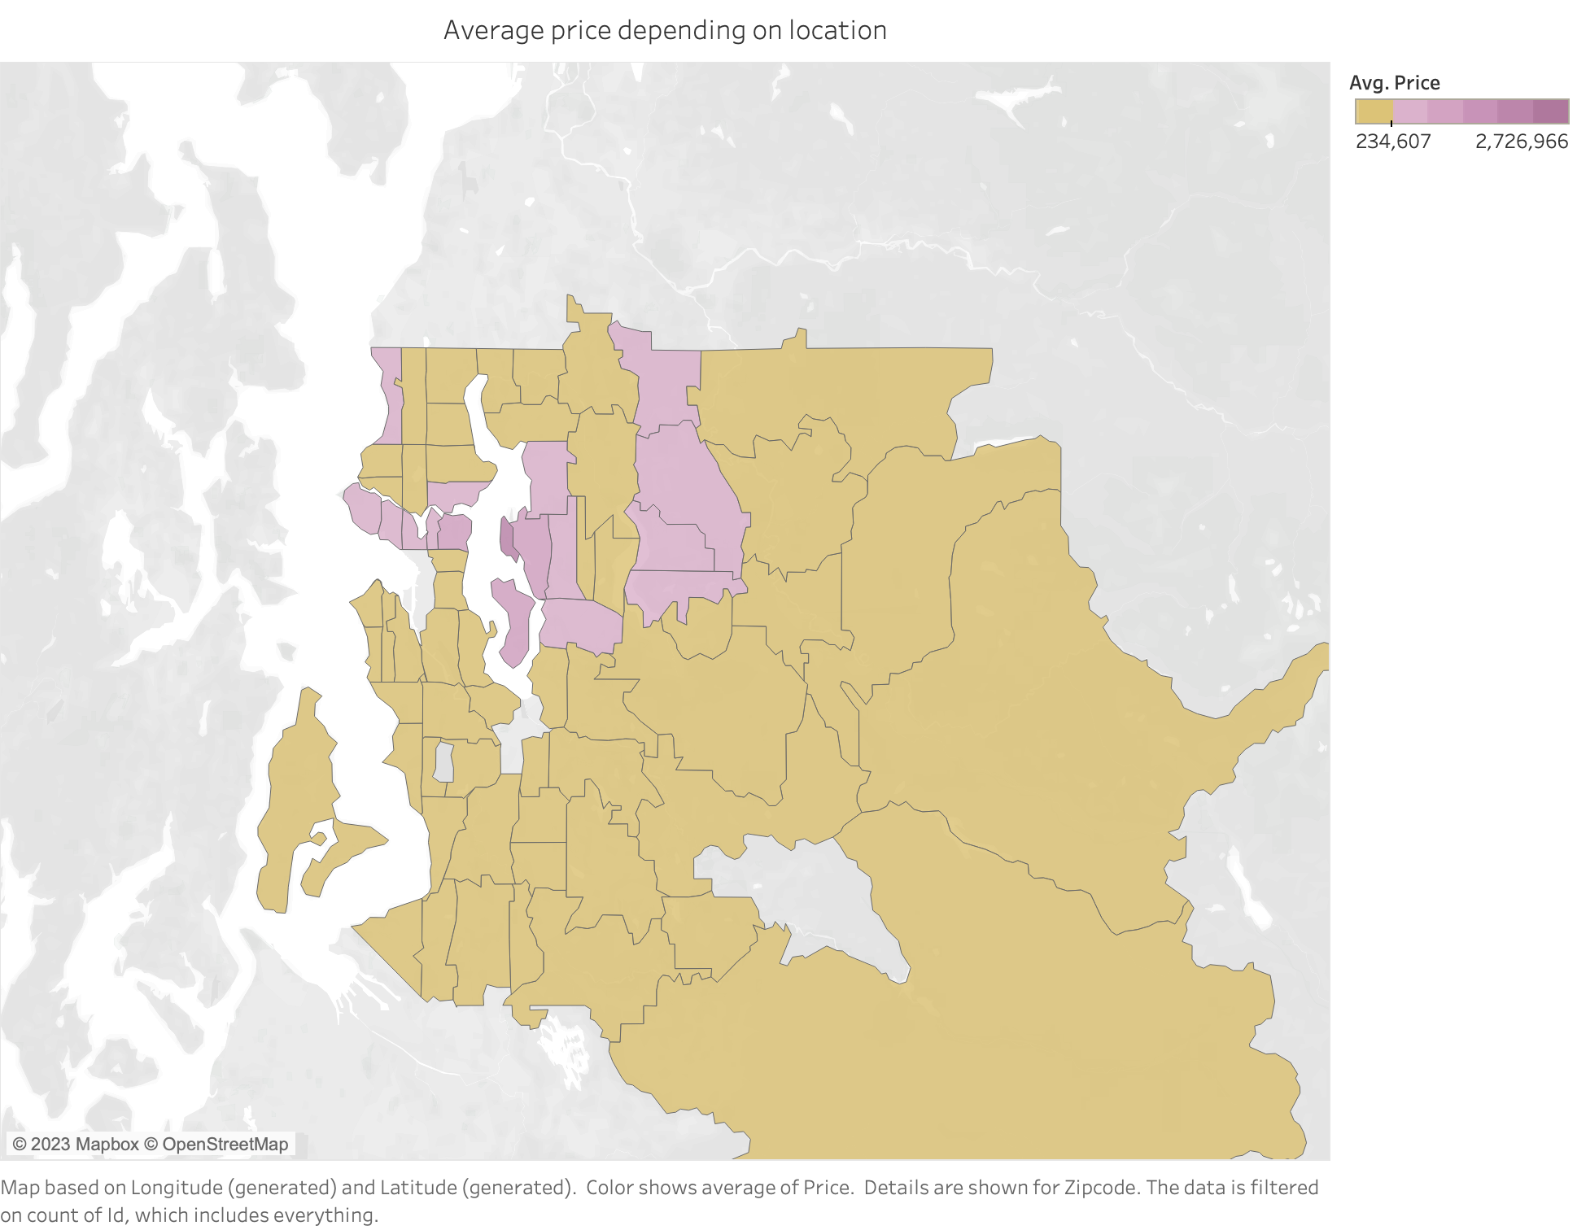
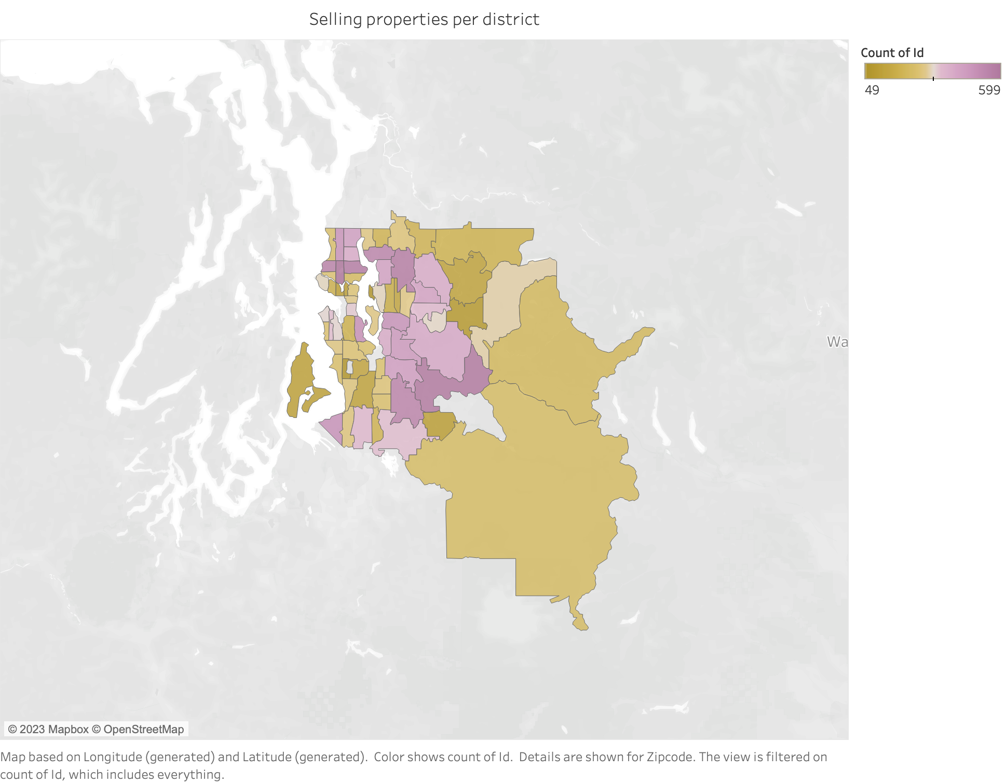

Slide 8
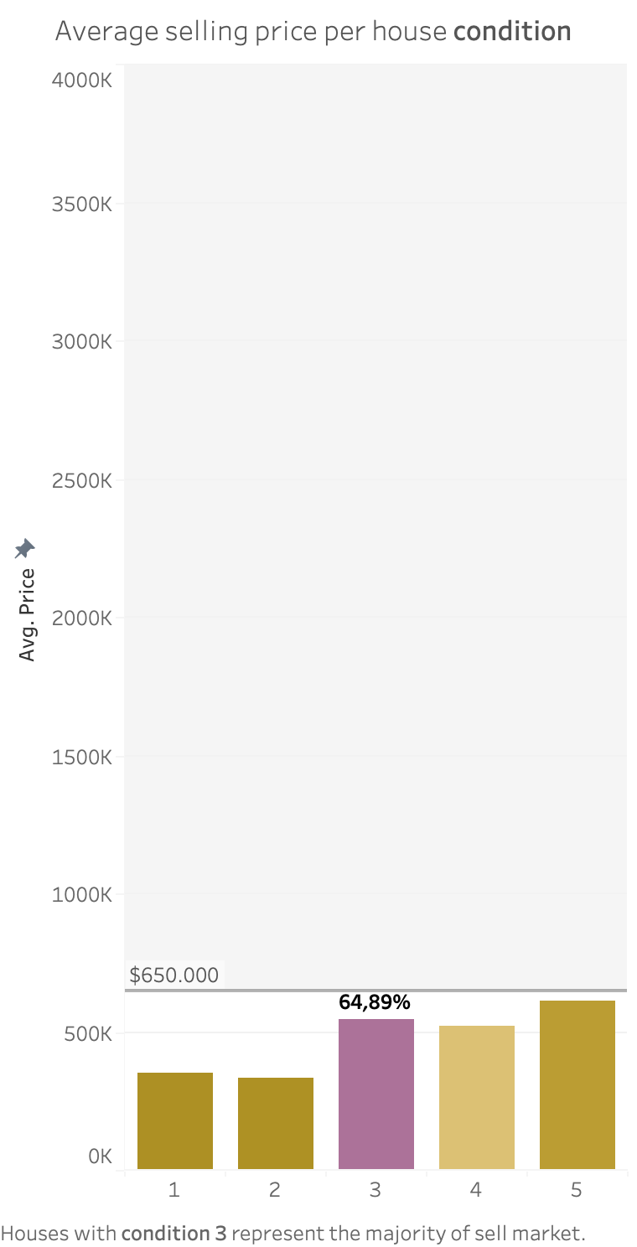
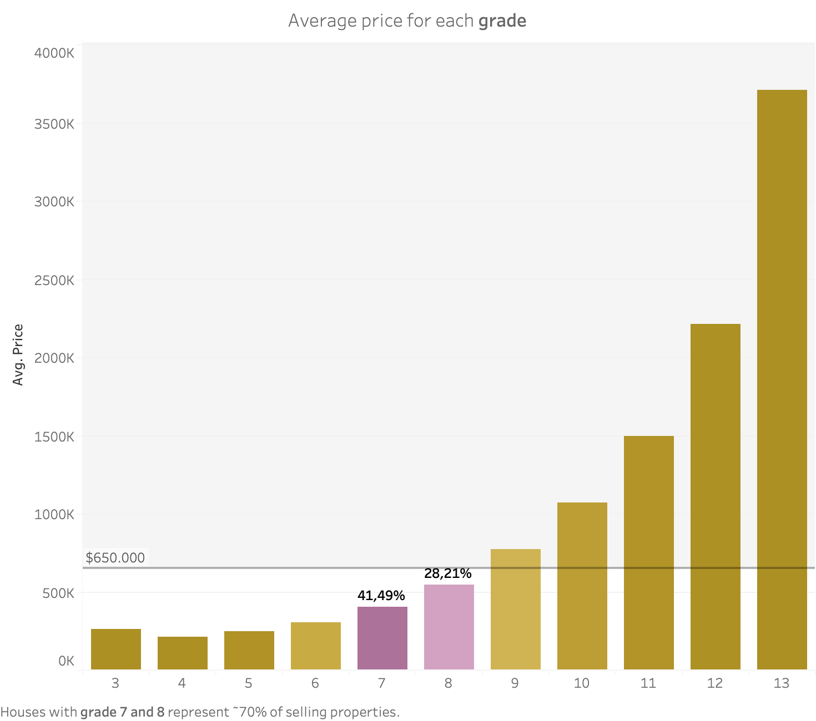

Slide 9
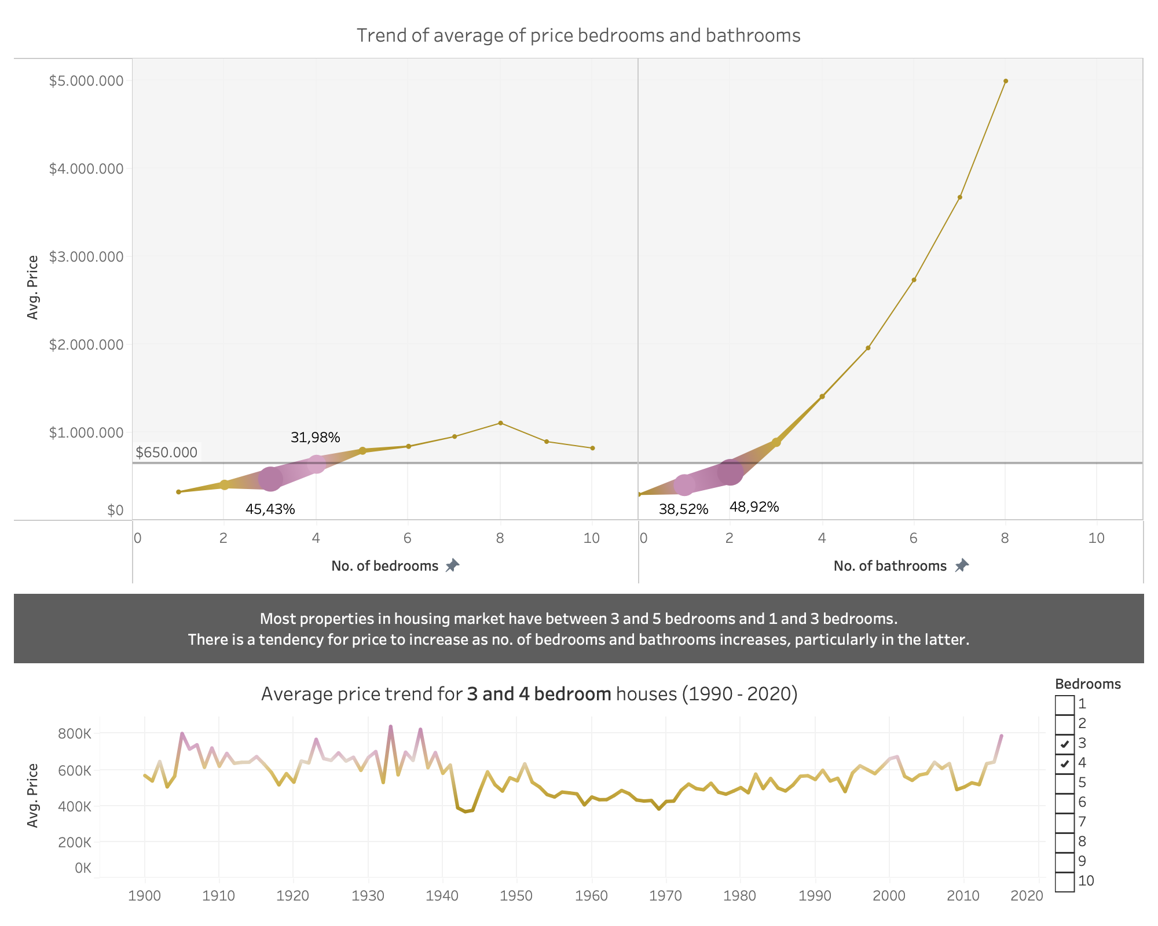

Slide 10
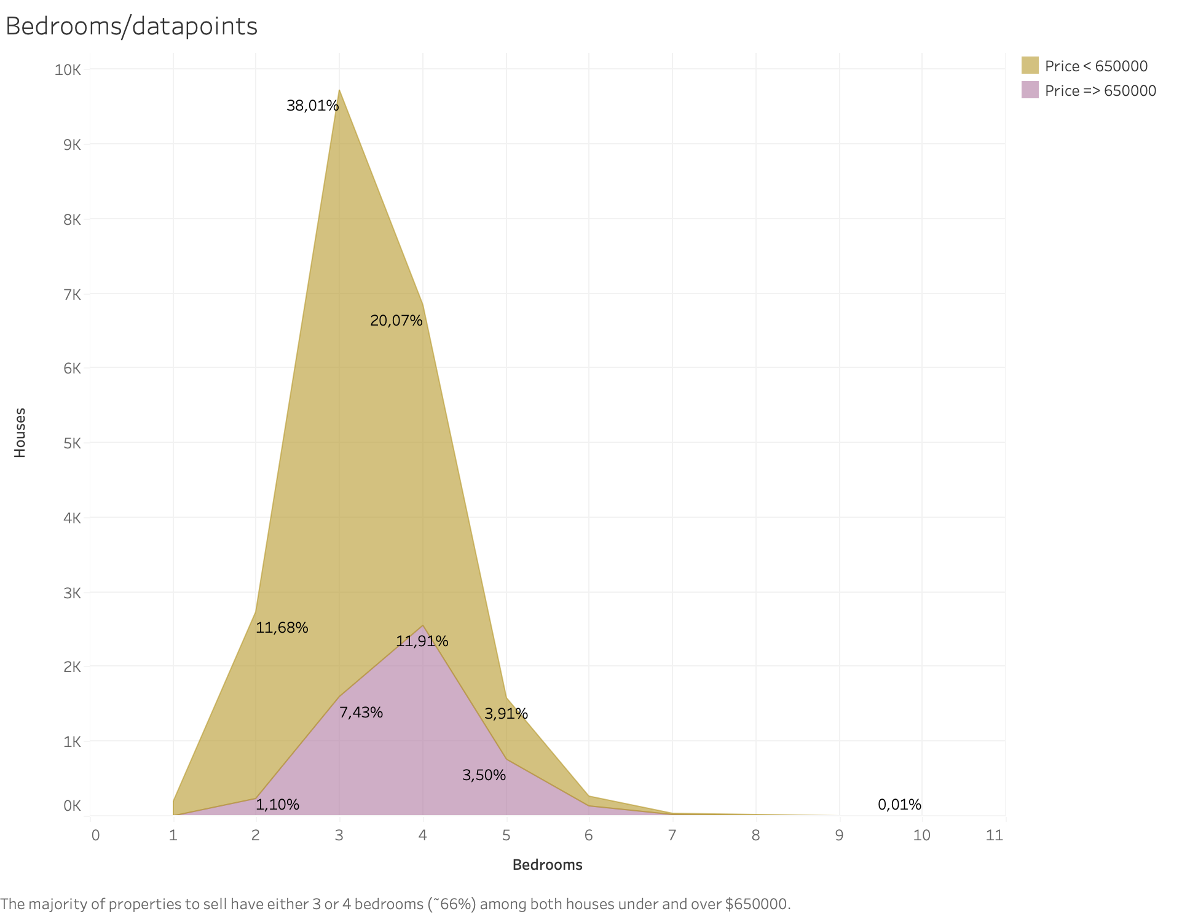

Slide 11
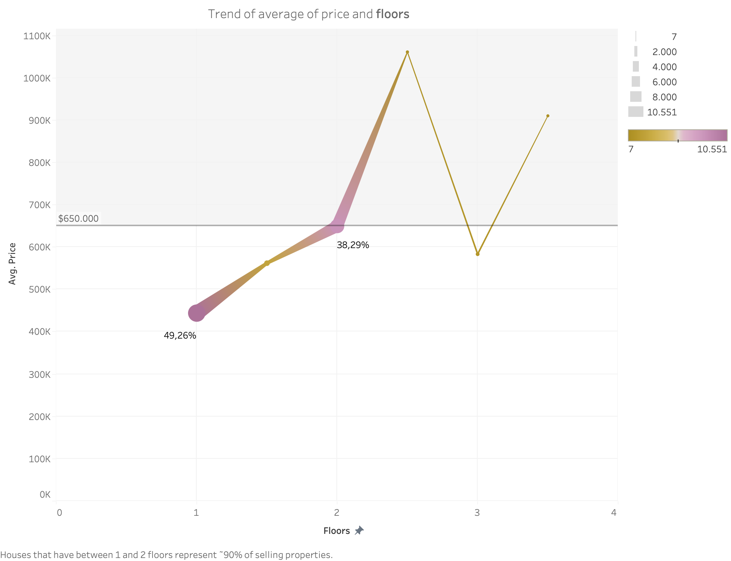

Slide 12
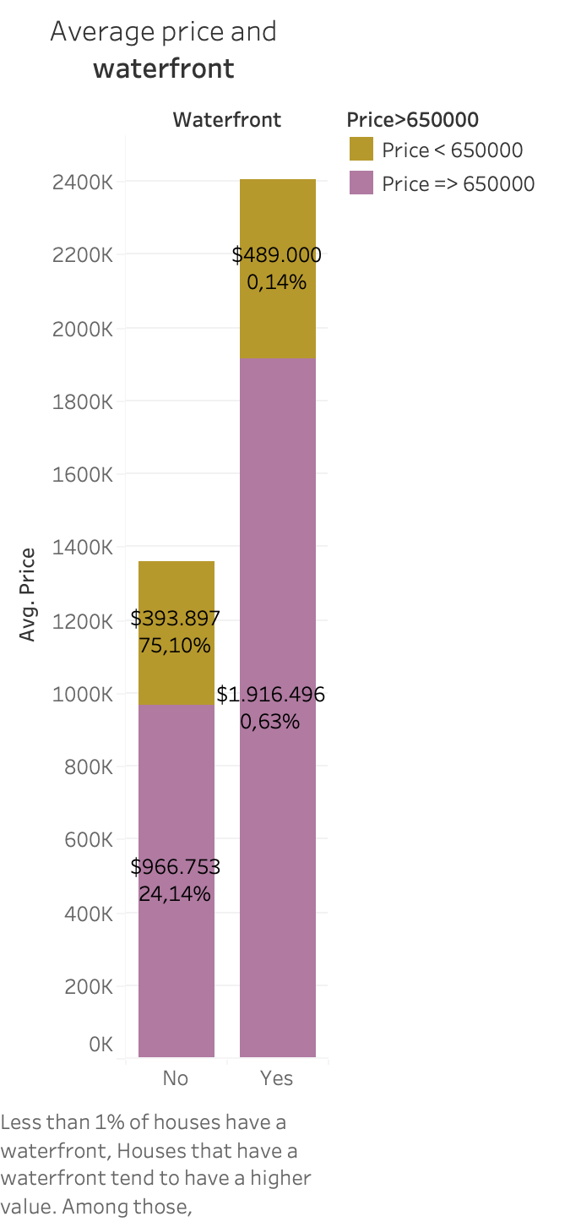
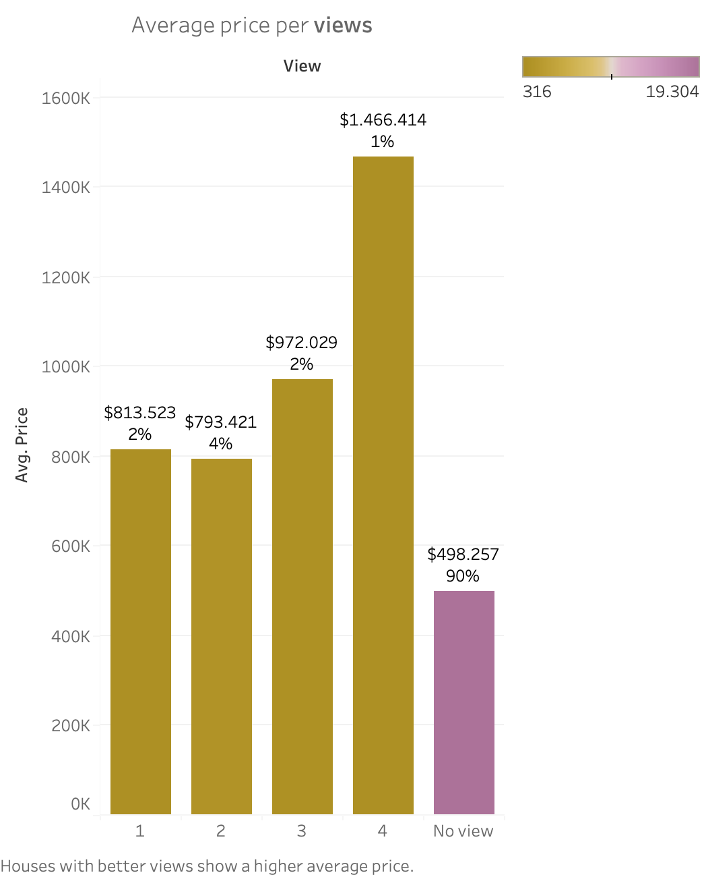

Slide 13
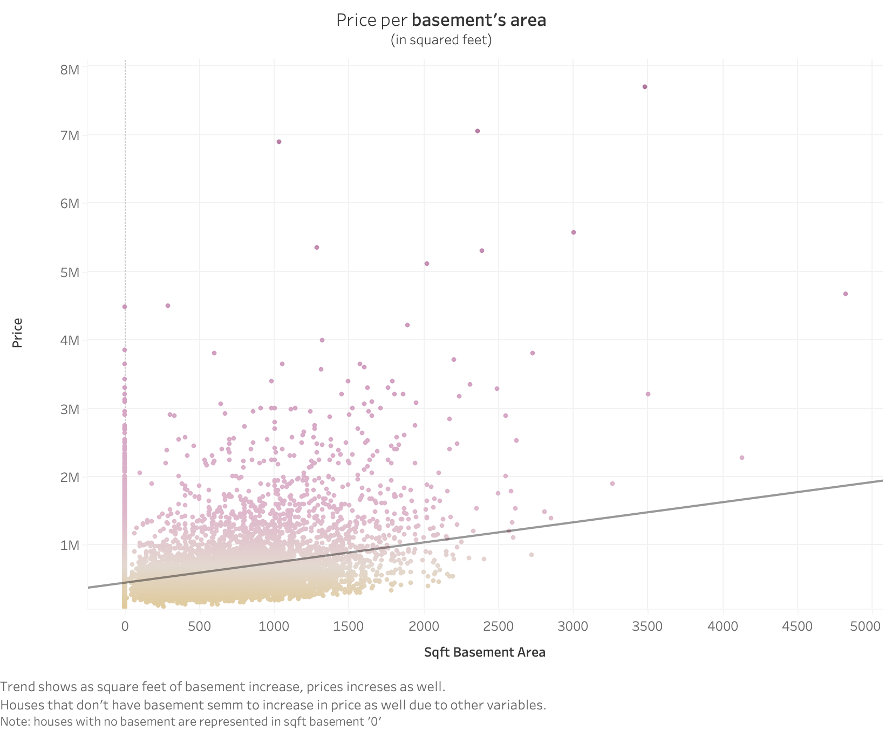
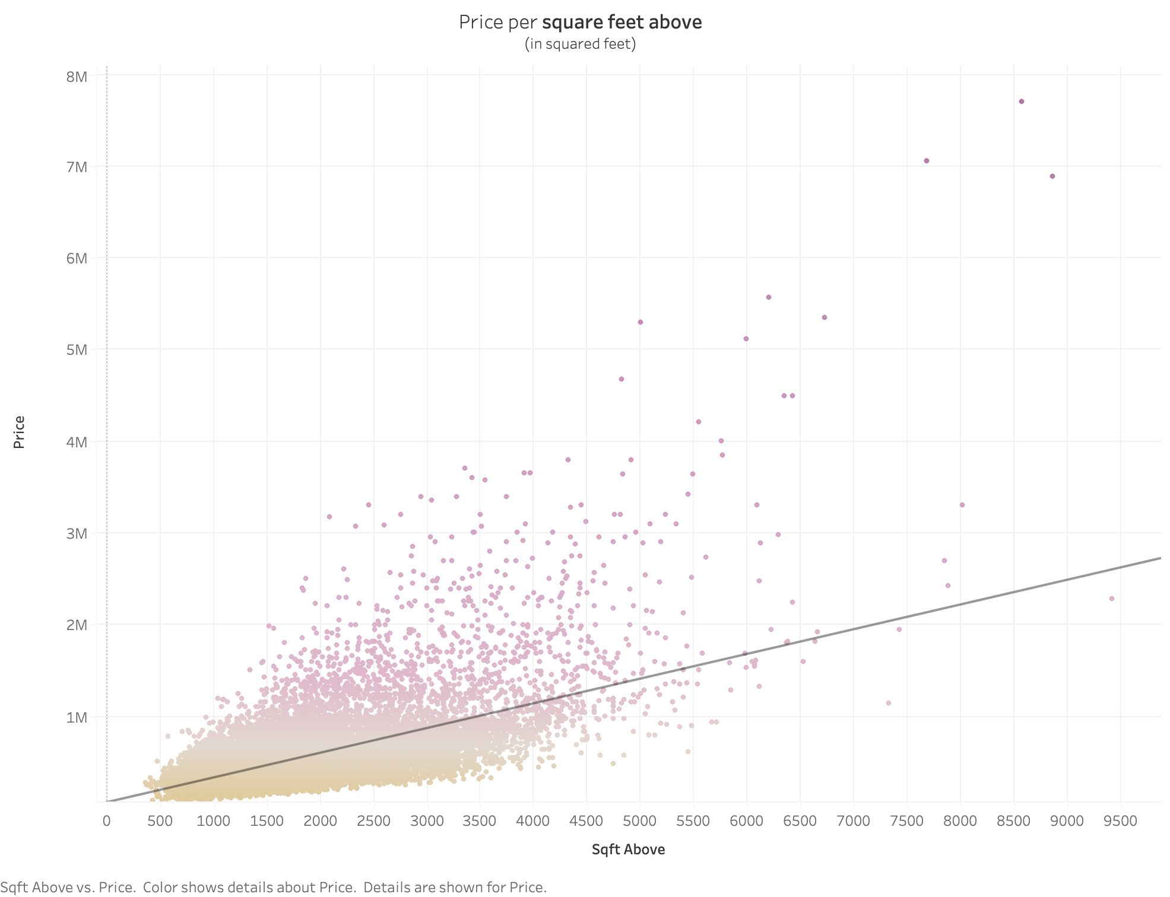
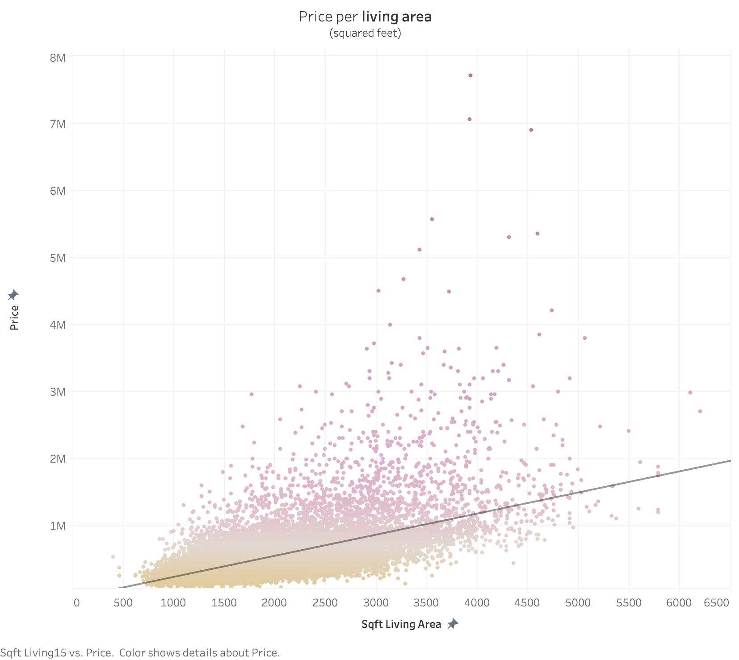
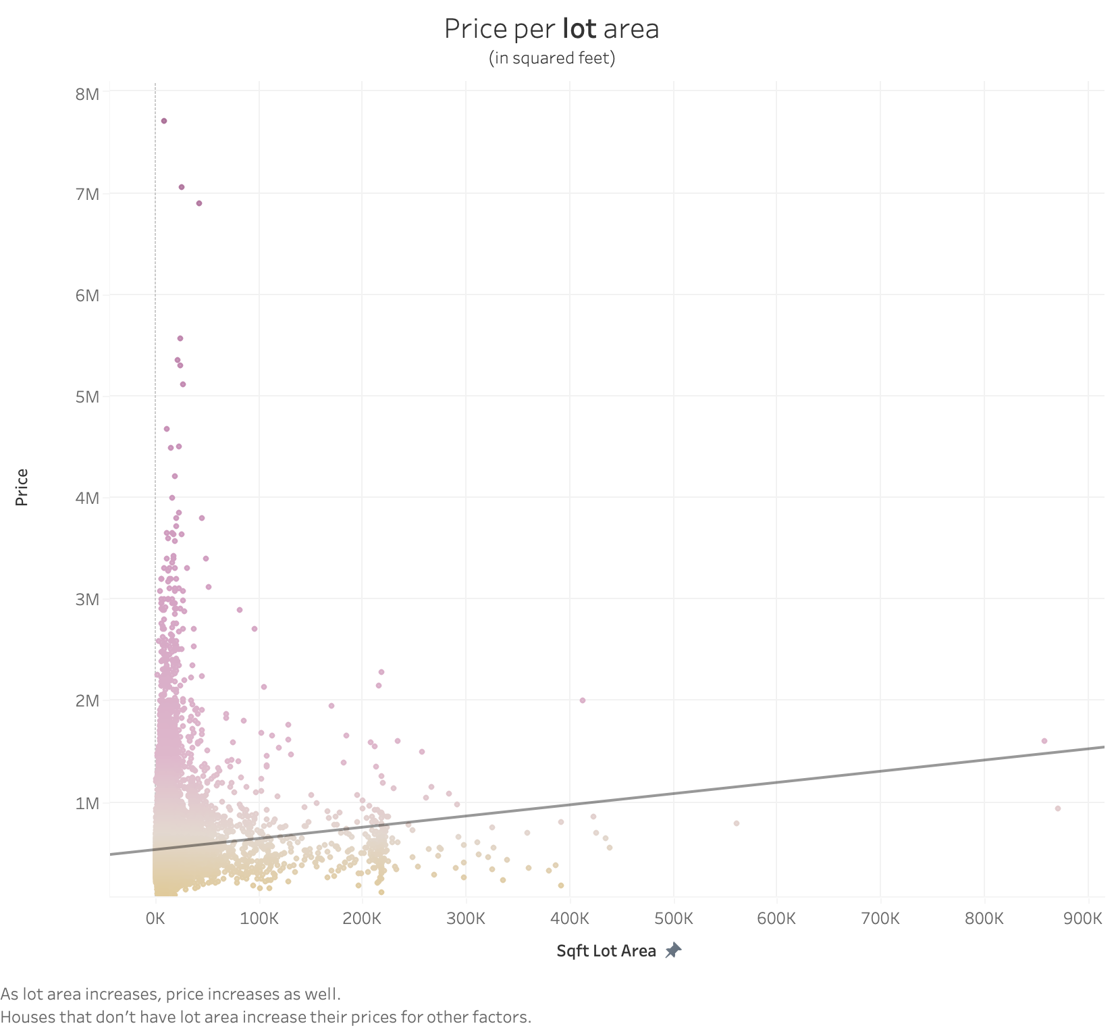
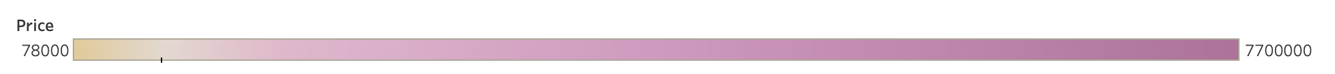

Slide 14
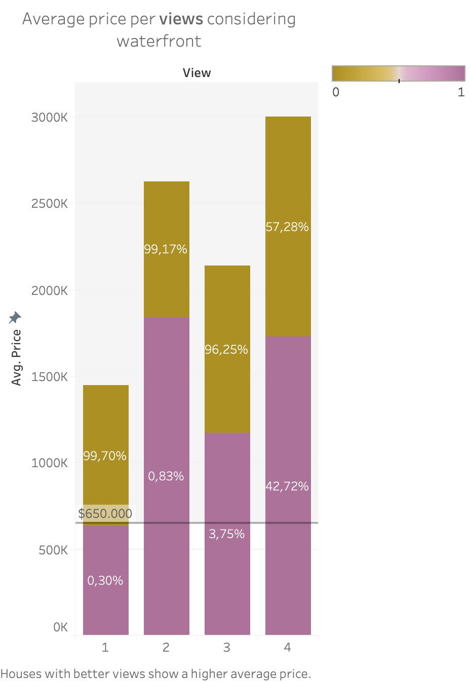
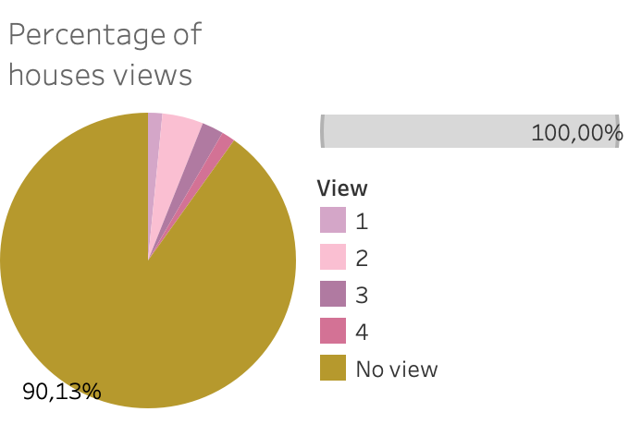

Slide 15
CONCLUSIONS
Model has an acceptable performance
Adjusted R-squared 0,76
Model OLS3 performs well when given new data
Low MSE meaning errors between predited and actual values are low.
New variables should be thought of in order to enhace model performance.
Further analysis could be performed:
Analyze houses vs department identified by features such as lot space and basement space.
Houses with no lot area or basement.
Reduce zipcode dummy variables grouping by average price.
Subset for unbalanced categorical variables
Eliminate outliers

